Slide 1

ICT LAW, POLICY AND ETHICS (CSE 407) Presentation On Applying IEEE-ACM Code of Ethics for the Software Engineers in Bangladesh: A Case Study
Course teacher :
Alida Binte Saqi
Lecturer, Department of Law
University of Asia Pacific
Notes:
tahura

Slide 2
Presented By
Serial | Name | Id
1. | Israt Jahan Isha | 17201001
2. | Biswambar Sarker | 17201005
3. | Rakefa Tus Sabah | 17201024
4. | Niamul Hasan | 17201026
5. | Tahura Nasrin | 17201031
6. | Md. Abdur Rahman Emon | 17201032
7. | Md Habibullah Sheikh | 17201049
Notes:
tahura

Slide 3

Definition
What is IEEE-ACM Code of Ethics ?
Notes:
isha

Slide 4

Why should we follow?
General ethical imperatives
Professional responsibilities
Leadership imperatives
Compliance with the code
Notes:
emon

Slide 5

Ethics in software Engineering
Software engineers shall act in a manner that is in the best interests of their client and employer consistent with the public interest.
Notes:
rakefa

Slide 6
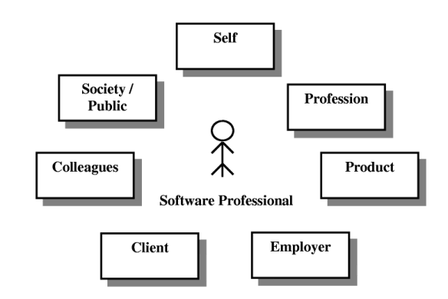
Eight Principles
1.Public Interest
2.Client and Employer
3.Product standards
4.Professional Judgment
5.Management
6.Profession
7.Colleagues
8.Self
Notes:
bisu

Slide 7

1.Public Interest
Accept full Responsibility
Be fair and avoid deception
Consider issues
Be encouraged
Notes:
habib

Slide 8

2.Client and Employer
Consistent with the public interest
Accept no outside work detrimental to the work they perform for their primary employer
Notes:
Niamul

Slide 9

3.Product standards
Understand specifications fully
Ensure you are suitably qualified
Ensure all goals are achievable
Ensure proper methodology use
Ensure good project management
Ensure all estimates are realistic
Notes:
tahura

Slide 10

4.Professional Judgment
Temper all technical judgments by the need to support and maintain human values.
Maintain professional objectivity.
Do not engage deceptive financial practices.
Disclose conflicts of interest to all concerned parties.
Notes:
isha

Slide 11

5.Management
1. Ensure that every project on which they develop is well-managed.
2. Ensure that there is a fair agreement concerning ownership of any software.
3. Not ask to do anything inconsistent with the Code.
4. No one should be punished for raising ethical questions about a project.
Notes:
emon

Slide 12

6.Profession
Maintain honesty with public interest.
Help develop an ethical environment.
Promote commitment of this code.
Support followers of this code.
Take responsible for errors.
Promote public knowledge.
Share software knowledge with the profession.
Notes:
rakefa

Slide 13

7.Colleagues
Encourage colleagues to adhere to this Code.
Assist colleagues in professional development.
Review the work of others in an objective, candid, and properly-documented way.
Give a fair hearing to the opinions, concerns, or complaints of a colleague.
Not unfairly intervene in the career of any colleague
Notes:
bisu

Slide 14

8.Self
Knowledge Development
Improve ability
Follow the government law
Not influence
Notes:
habib

Slide 15
How we initiated Our Case study
On perspective of Bangladesh
(Analysis report)
Survey on software engineering professionals
Survey on CSE students
Notes:
Niamul

Slide 16
Conclusion
Software engineering involves a large number of professionals to together with upmost co ordination.It is their fore necessary that all code of ethics in this field be followed by all members and stakeholders so as to be loyal to their duties and minimize conflict and errors.This will ensure that end products delivered by software engineering bodies be meaningful and best standards.
Notes:
tahura

Slide 17


